Slide 1

Conway's Game of Life
Sonal Chavan
Charishma Marada

Slide 2
Statement of Problem & requirements
The game of life is a grid of cells where each cell is in the state of being alive or not. The next generation of the game depends on the current generation and some strict set of rules, which we encoded into our algorithm.
The user can select from various predetermined patterns, and watch the progression of life
The user can select multiple options as a input like Start the game, Stop the game , Increment 1 generation, Increment 23 generations, Reset the game, select Pattern

Slide 3
Design & Methodology
Agile - is best suited for projects that are iterative and incremental. It’s a type of process where demands and solutions evolve through the collaborative effort of self-organizing and cross-functional teams and their customers.
We followed Agile methodology to implement our project and held meetings to finish the work based on our availability

Slide 4
UML Diagram

Slide 5
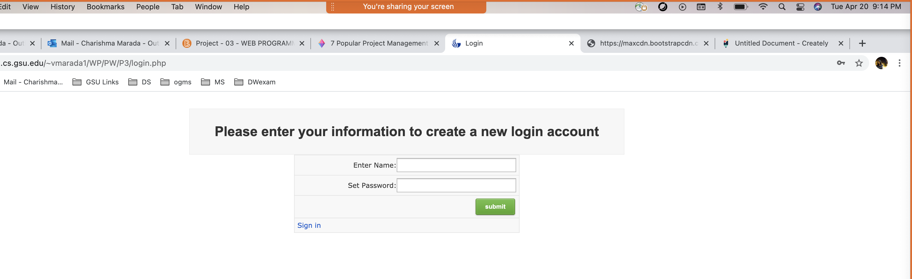
Sign In Page

Slide 6

Login Page

Slide 7
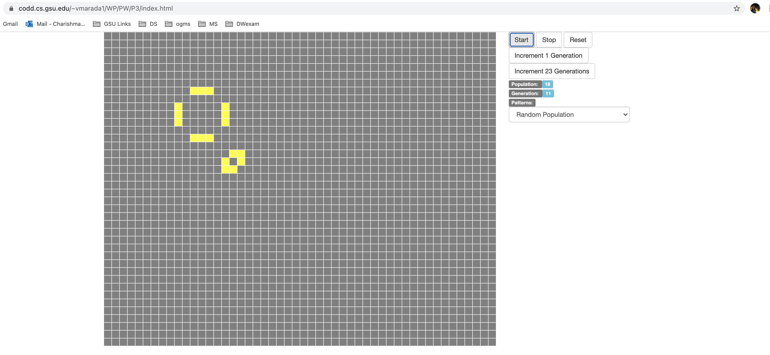
Main page

Slide 8
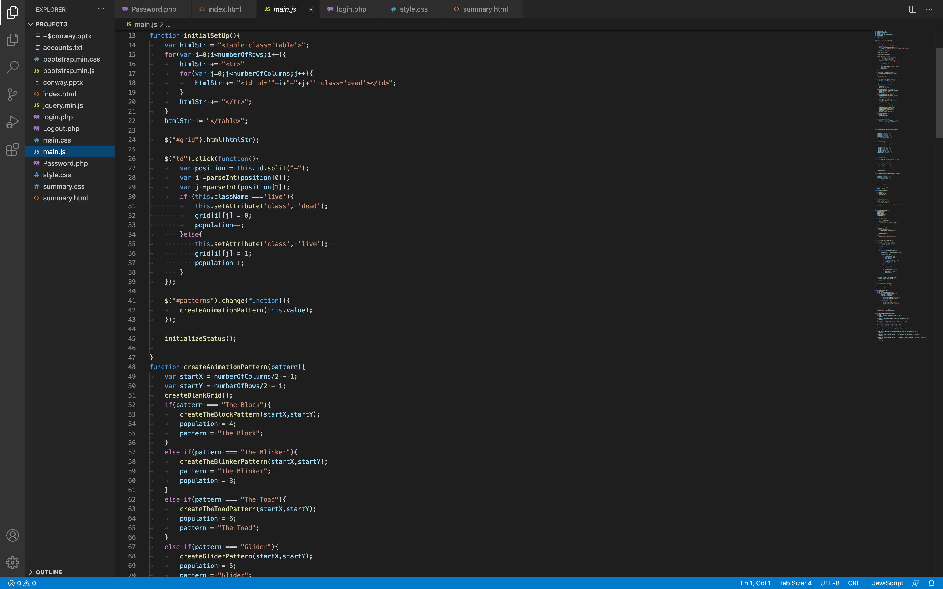
Pseudo Code

Slide 9
Testing
Chrome
Safari
Internet Explorer
Edge

Slide 10

Thank you

